Slide 1

Ishan Budhiraja 2K18/EE/087

Slide 2
Detection and Location of Faults in Underground Cable using Matlab Simulink

Slide 3
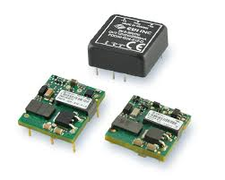
Project analysis slide 2
Introduction
A DC-to-DC converter is an electronic circuit or electromechanical device that converts a source of direct current from one voltage level to another. It is a type of electric power converter. Power levels range from very low to very high

Slide 4
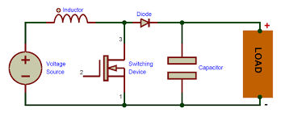
Project analysis slide 2
Conventional Dc-Dc boost Converter
A boost converter (step-up converter) is a DC-to-DC power converter that steps up voltage from its input to its output . It is a class of switched-mode power supply (SMPS) containing at least two semiconductors (a diode and a transistor) and at least one energy storage element: a capacitor, inductor, or the two in combination. To reduce voltage ripple, filters made of capacitors are normally added to such a converter's output and input

Slide 5
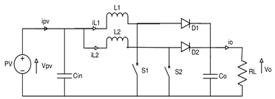
Project analysis slide 2
Interleaved Dc-Dc boost Converter
The interleaved boost converter consists of two single-phase boost converters connected in parallel

Slide 6
Project analysis slide 2
Simulation
Parameters | CONVENTIONAL BOOST CONVERTER | INTERLEAVED BOOST
INDUCTANCE | 3mH | 3mH
CAPACITANCE | 10mF | 10mF
RESISTIVE LOAD | 12ohm | 12ohm

Slide 7
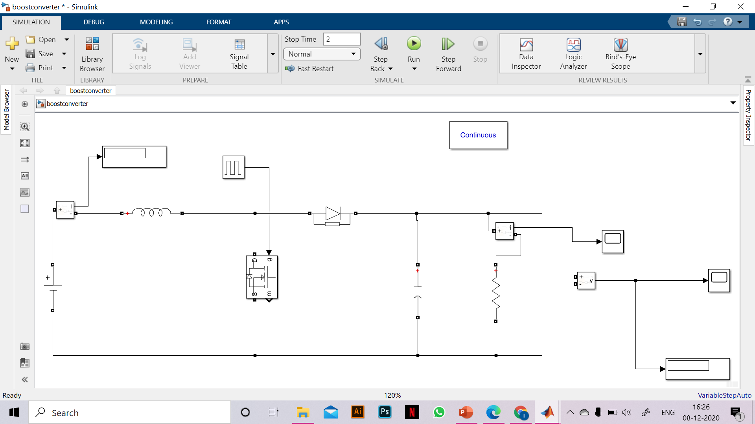
Project analysis slide 2
Simulation

Slide 8
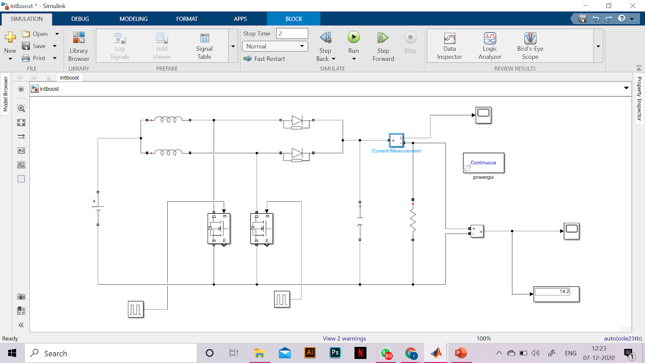
Project analysis slide 2
Simulation

Slide 9
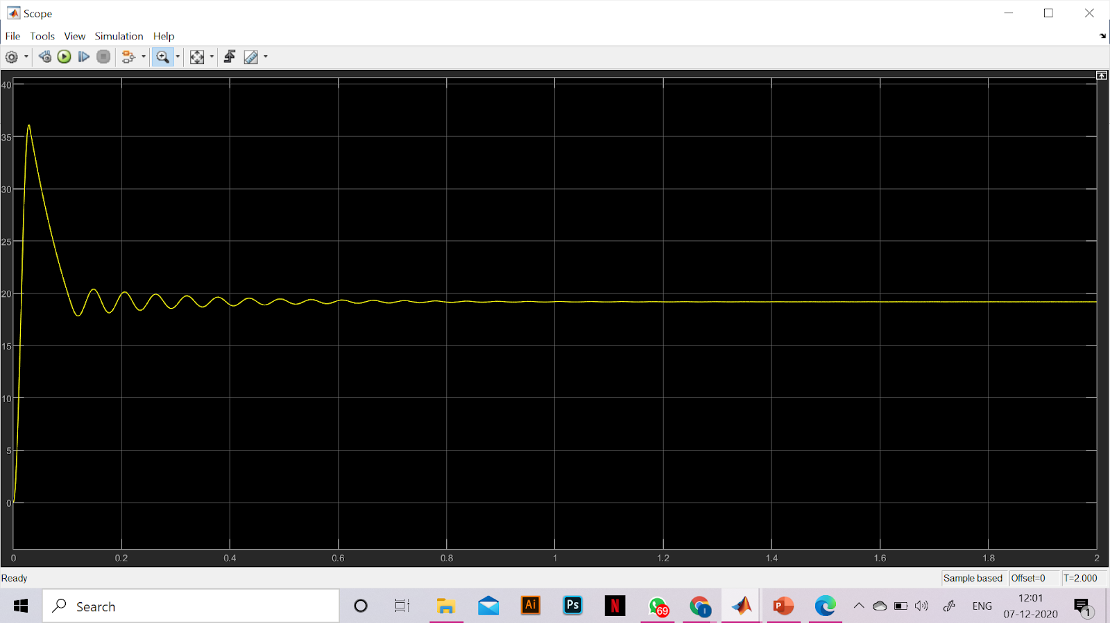
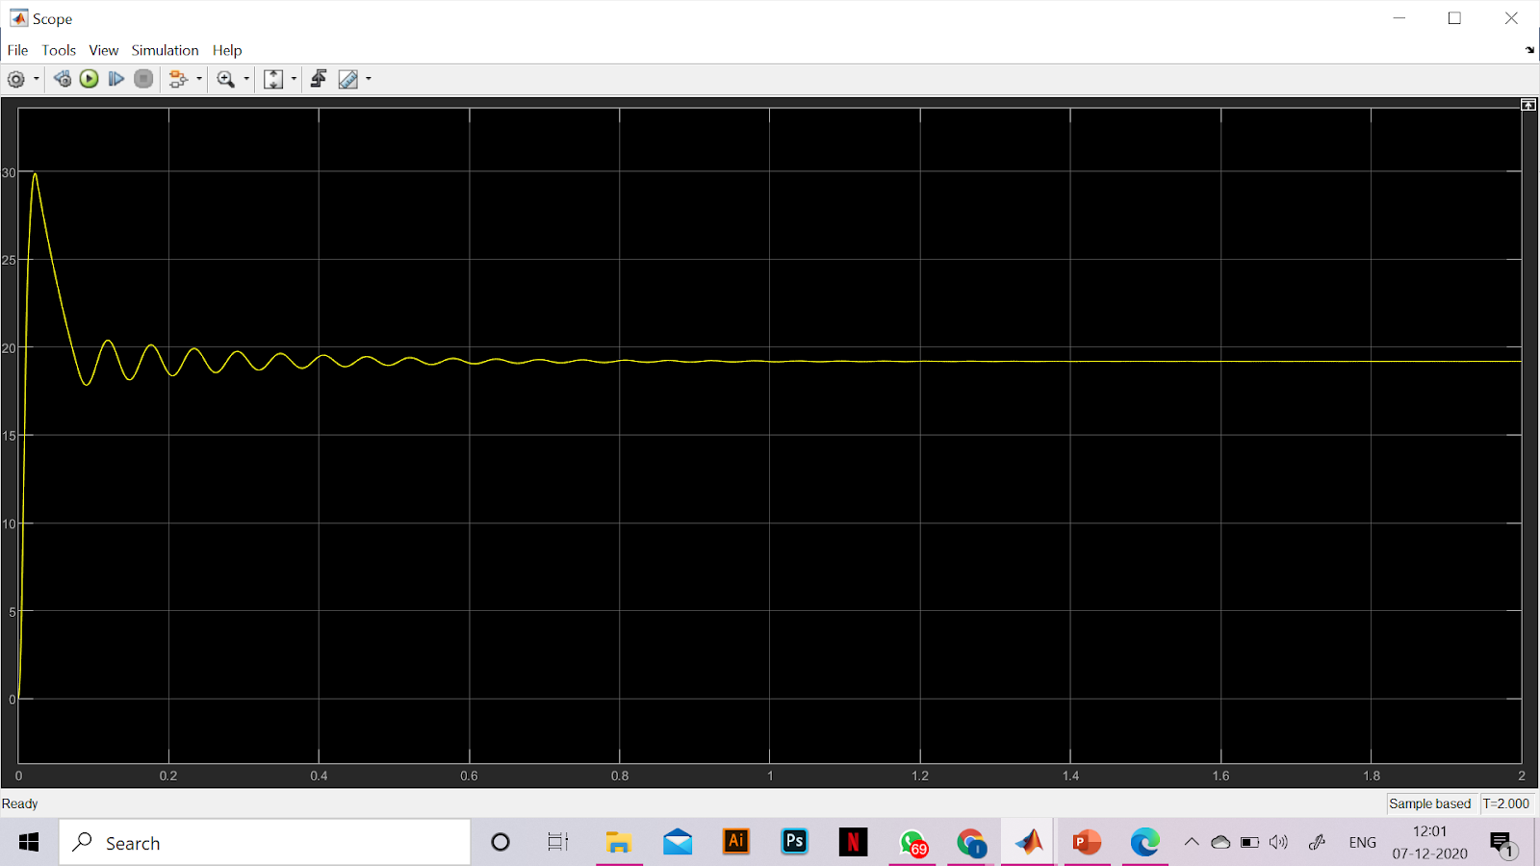
Project analysis slide 2
Results
Input Voltage = 9
Simulated output Voltage = 29.25
Efficiency= 95.4%
Input Voltage = 9
Simulated output Voltage = 30.15
Efficiency= 97.7%

Slide 10
Project analysis slide 2
Conclusion
Using an interleaving procedure, the input voltage V is increased more
The system is capable of supplying more effective power to the load.
Compared to traditional boost converters, the Interleaved boost converter has more advantages such as high performance, low ripple, etc.
For applications such as high-efficiency converters, a power factor correction circuit, and battery chargers, the interleaved boost converter is also suited.

